Slide 1
What This Project Is About
Simulated daily risk for a portfolio of Apple, Microsoft, Google, and Amazon using real stock price data.

Slide 2
Why It Matters
Investors care about losses.
This project shows how much you might lose in a single day, with 95% confidence.

Slide 3
What I Did
Collected real market data
Built a 4-stock portfolio
Estimated 1-day loss risk
Compared 3 risk models

Slide 4
How I Predicted Risk
📌 3 VaR Models Used:
Normal Distribution – assumes returns are bell-shaped
Student's t-Distribution – captures fat tails (extreme events)
Historical Simulation – uses real past data to estimate risk

Slide 5
Key Result
Most days, losses stayed under 2.9%.
Rare worst-case days could go beyond 3%.
Different models gave slightly different VaR estimates.

Slide 6
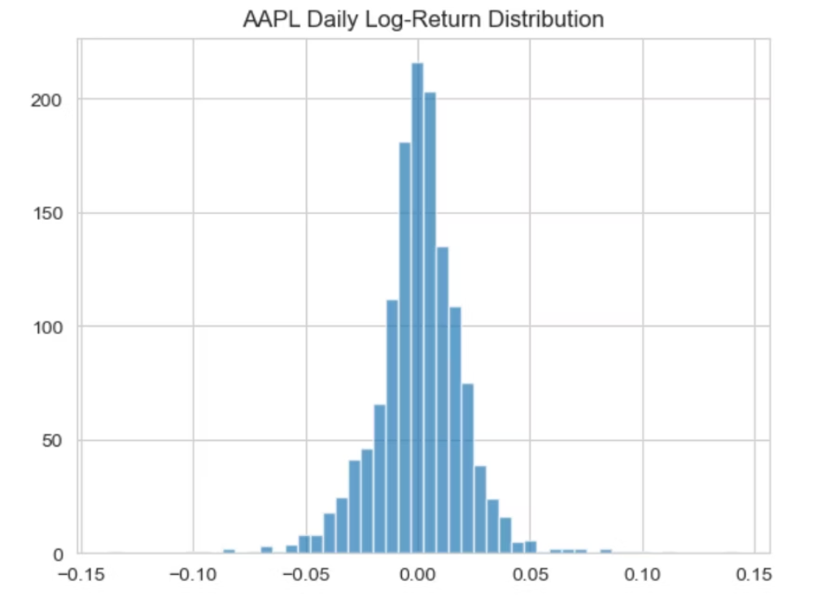
What It Looks Like
-Return distribution

Slide 7
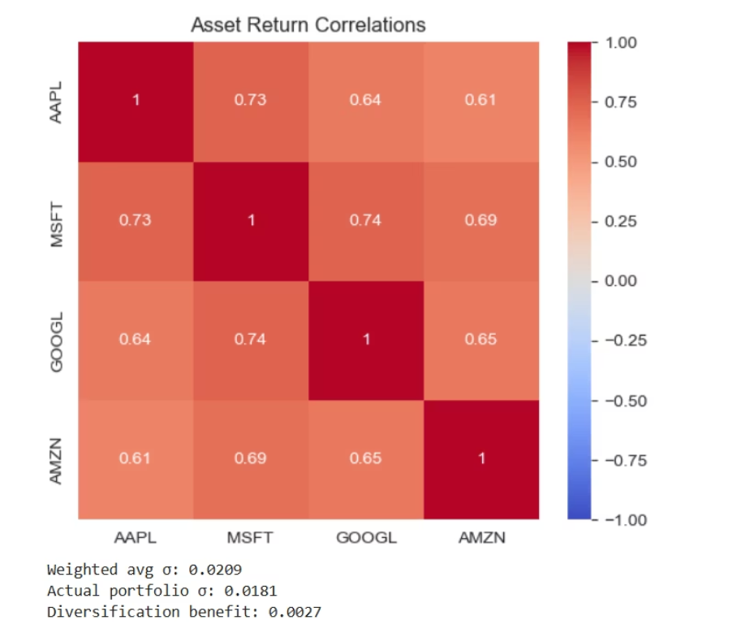
- Correlation heatmap

Slide 8
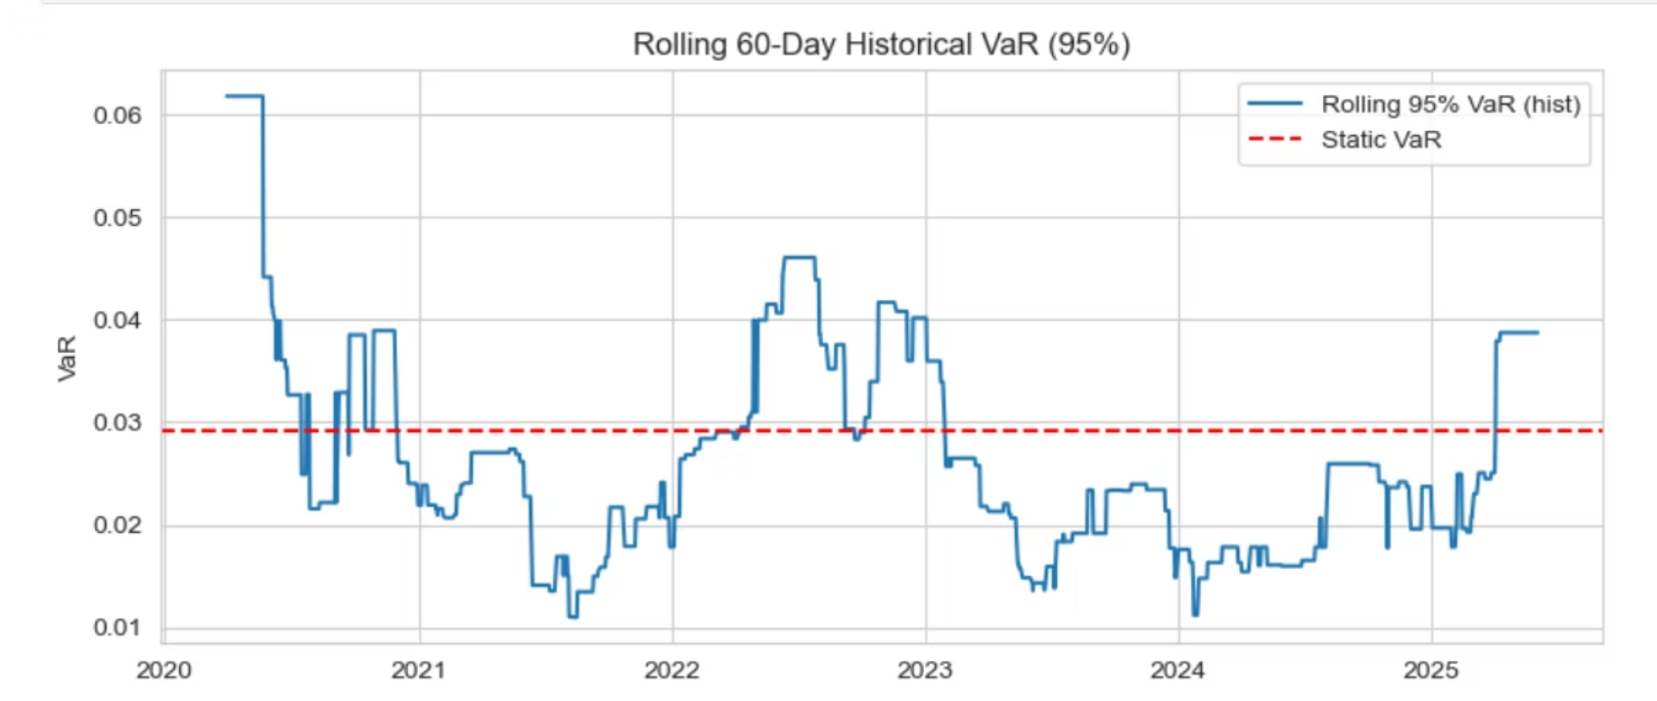
- Rolling VaR chart

Slide 9
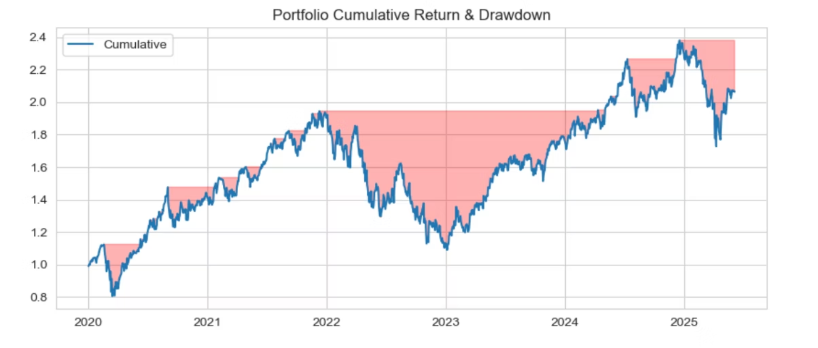
- Drawdown analysis

Slide 10
What I Learned
Risk models depend heavily on assumptions
Real data is not always 'normal'
Diversification really reduces volatility
Visual storytelling helps explain complex results

Slide 11
Explore the Full Project
🔗 GitHub

